Slide 1
First Law of Thermodynamics
Energy is neither created nor destroyed.
In other words, the total energy of the universe is a constant; if the system loses energy, it must be gained by the surroundings, and vice versa.

Slide 2
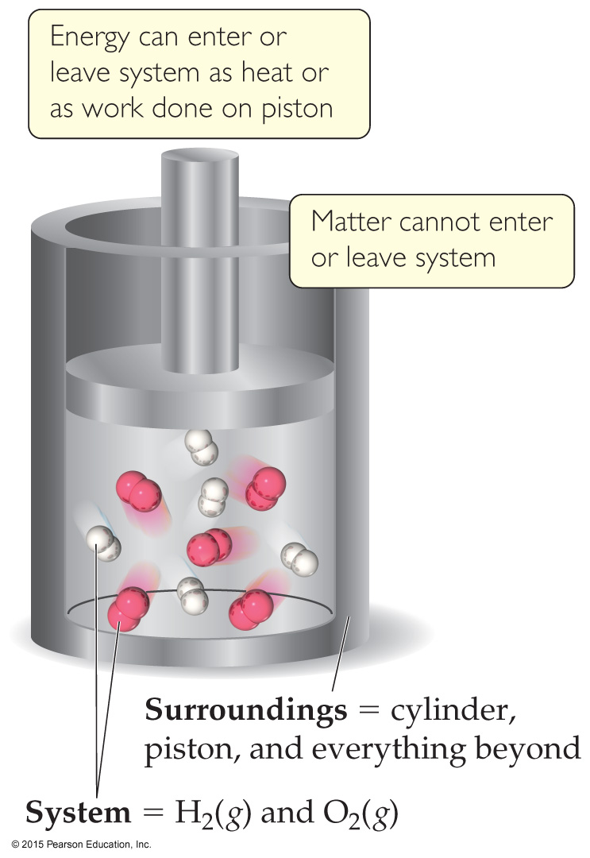
Definitions: System and Surroundings
The system includes the molecules we want to study (here, the hydrogen and oxygen molecules).
The surroundings are everything else (here, the cylinder and piston).
Notes:
Limited and well defined part of the universe

Slide 3
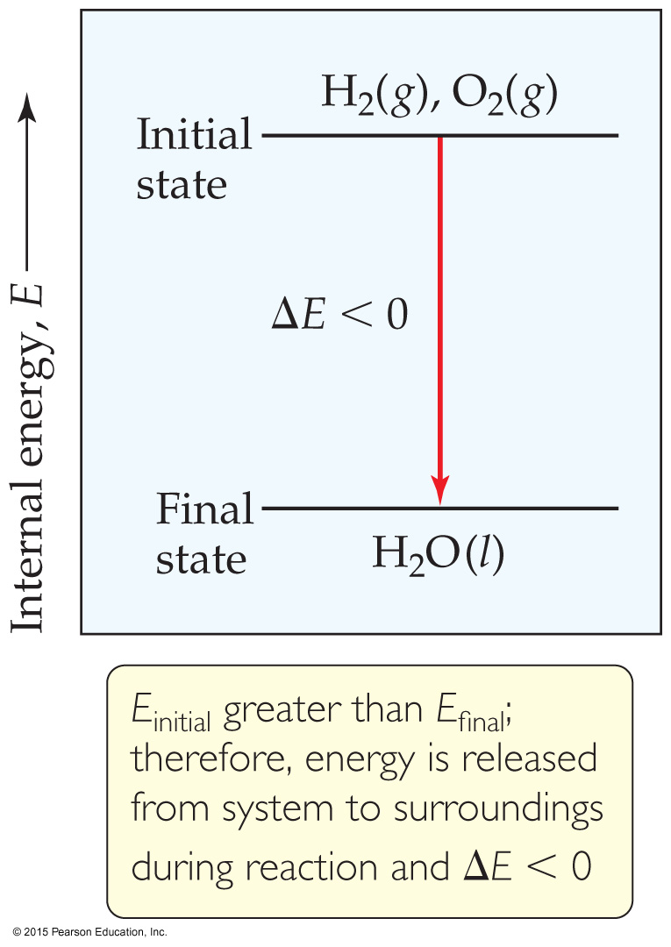
Internal Energy
By definition, the change in internal energy, ΔE, is the final energy of the system minus the initial energy of the system:
ΔE = E_{final} − E_{initial}

Slide 4
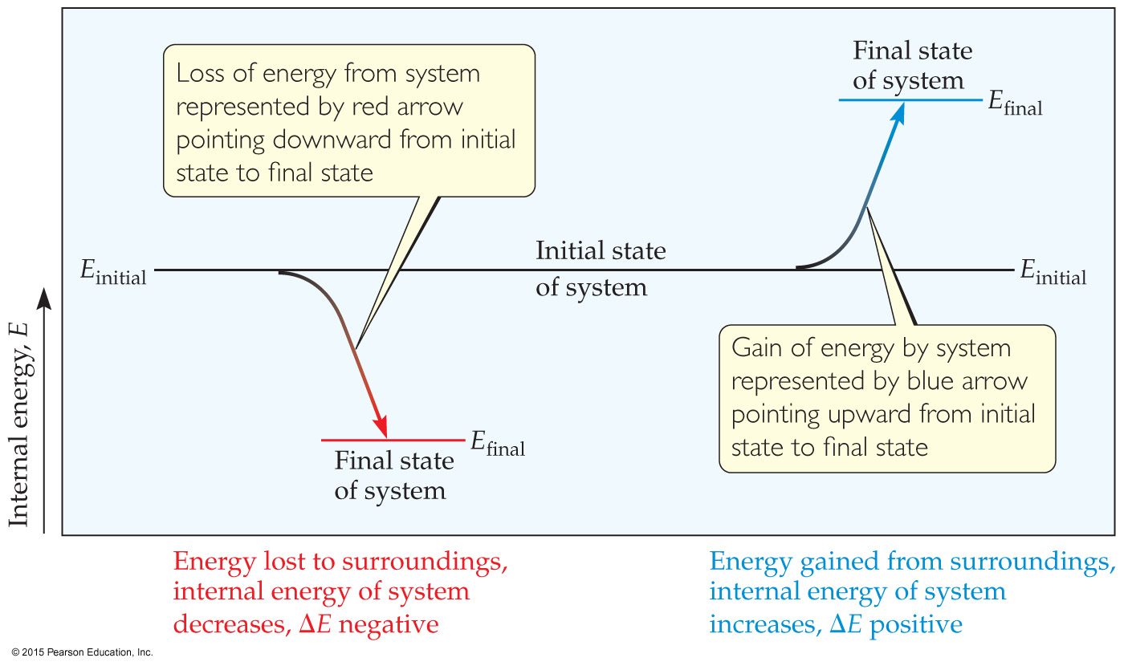
Changes in Internal Energy
If ΔE > 0, E_{final} > E_{initial}
Therefore, the system absorbed energy from the surroundings.
This energy change is called endergonic.

Slide 5
Changes in Internal Energy
If ΔE < 0, E_{final} < E_{initial}
Therefore, the system released energy to the surroundings.
This energy change is called exergonic.

Slide 6
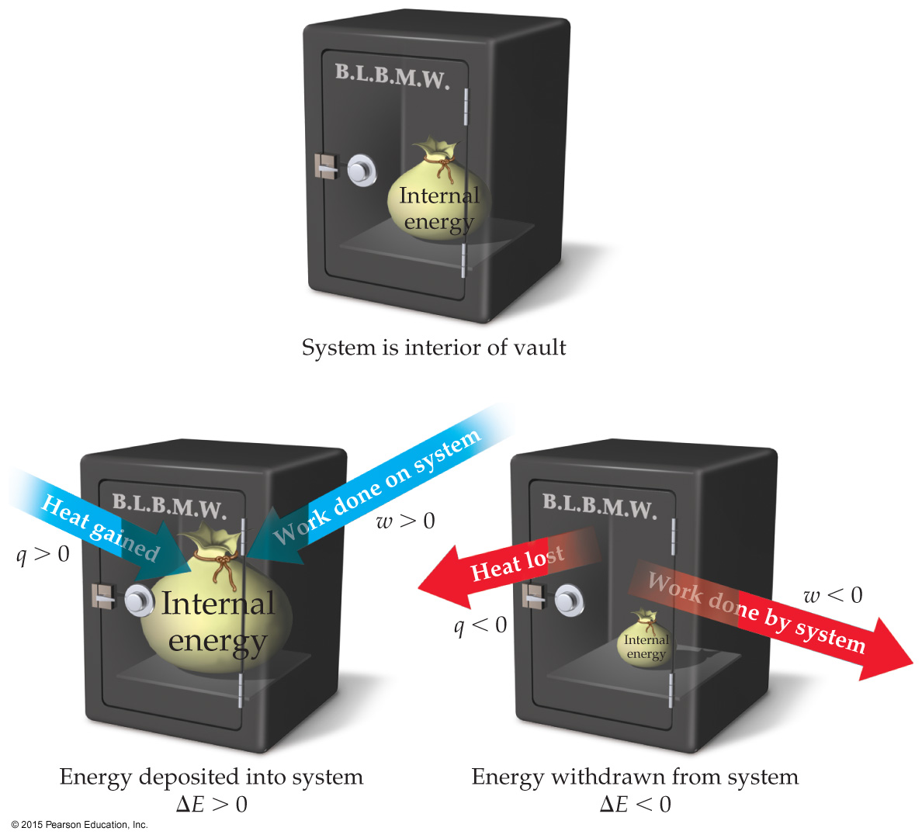
Changes in Internal Energy
When energy is exchanged between the system and the surroundings, it is exchanged as either heat (q) or work (w).
That is, ΔE = q + w.

Slide 7
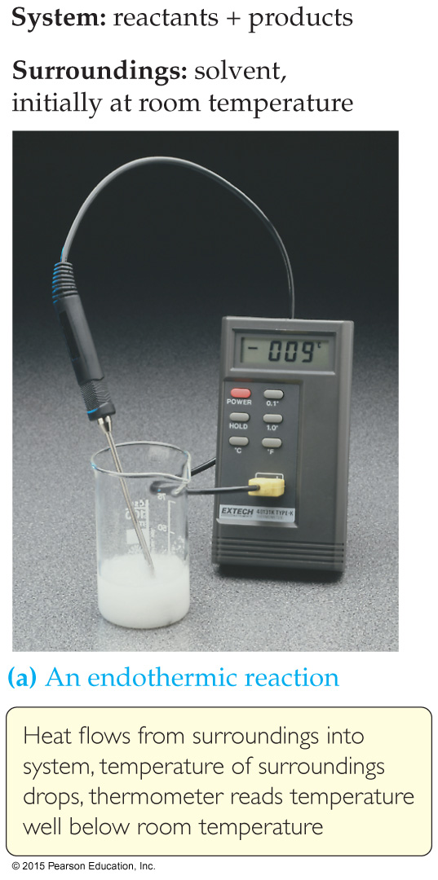
Exchange of Heat between System and Surroundings
When heat is absorbed by the system from the surroundings, the process is endothermic.

Slide 8
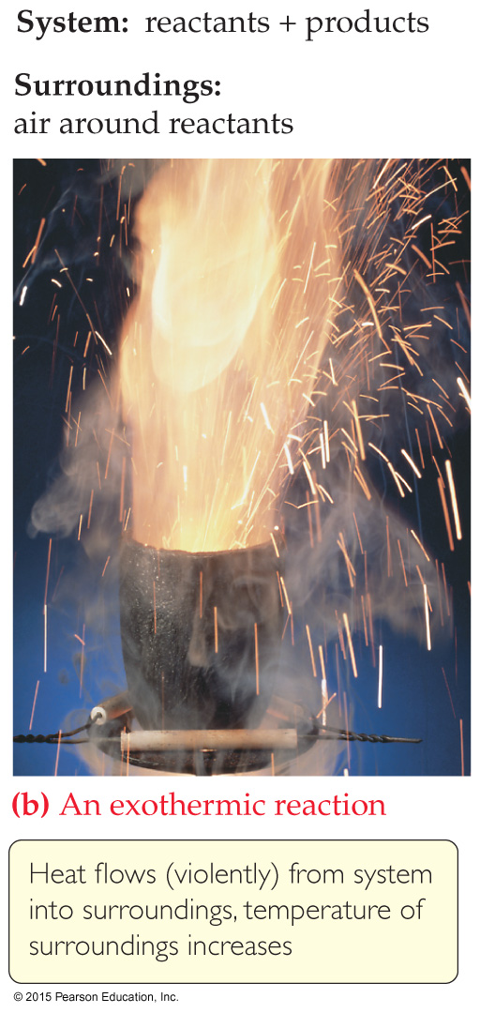
Exchange of Heat between System and Surroundings
When heat is released by the system into the surroundings, the process is exothermic.

Slide 9
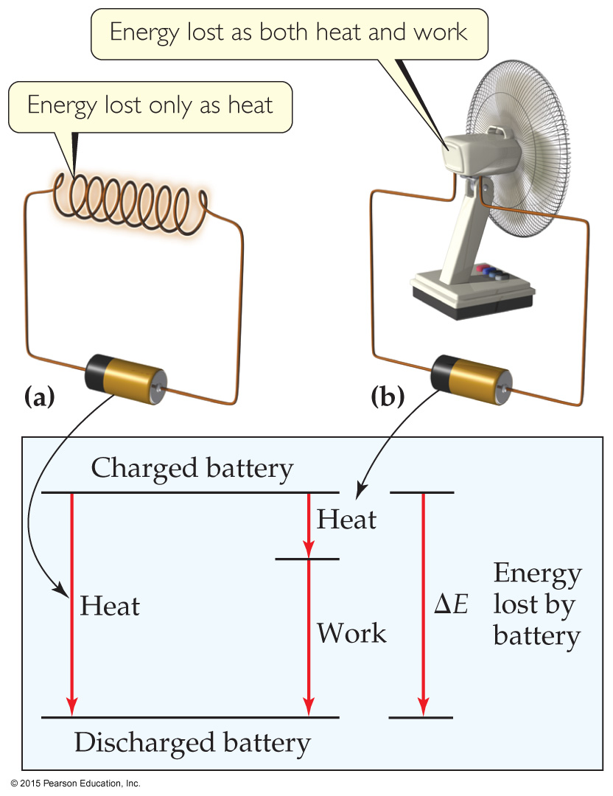
State Functions
However, q and w are not state functions.
Whether the battery is shorted out or is discharged by running the fan, its ΔE is the same.
But q and w are different in the two cases.

Slide 10
Enthalpy
Since ΔE = q + w and w = −PΔV, we can substitute these into the enthalpy expression:
ΔH = ΔE + PΔV
ΔH = (q + w) − w
ΔH = q
So, at constant pressure, the change in enthalpy is the heat gained or lost.

Slide 11
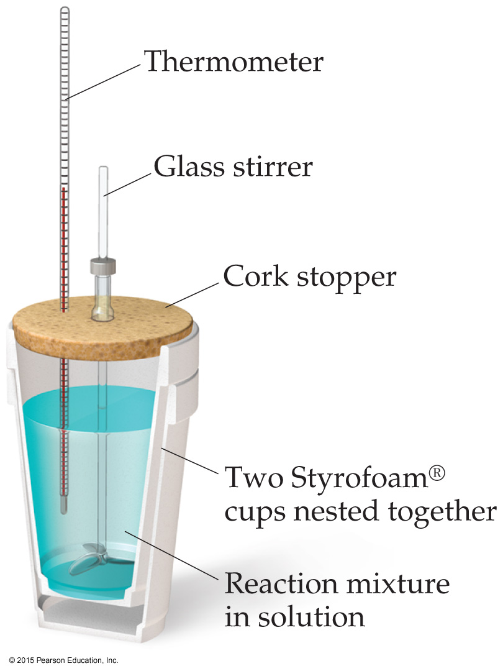
Constant Pressure Calorimetry
By carrying out a reaction in aqueous solution in a simple calorimeter, the heat change for the system can be found by measuring the heat change for the water in the calorimeter.
The specific heat for water is well known (4.184 J/g∙K).
We can calculate ΔH for the reaction with this equation:
q = m × C_{s} × ΔT

Slide 12
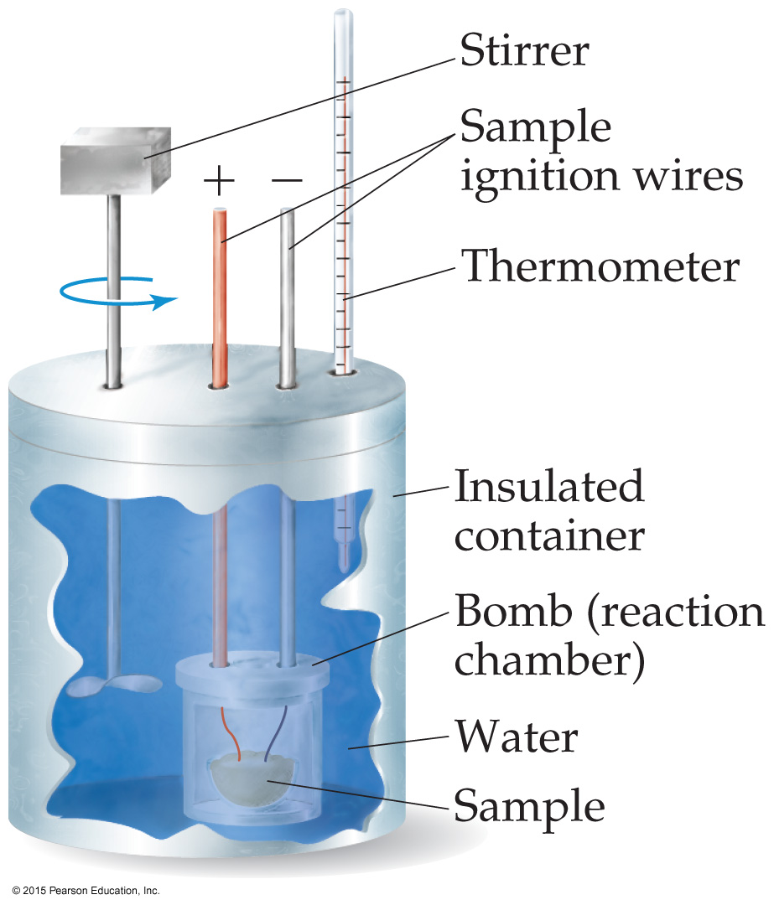
Bomb Calorimetry
Because the volume in the bomb calorimeter is constant, what is measured is really the change in internal energy, ΔE, not ΔH.
For most reactions, the difference is very small.
ΔH = ΔE + PΔV

Slide 13
Enthalpies of Formation
An enthalpy of formation, ΔH_{f}, is defined as the enthalpy change for the reaction in which a compound is made from its constituent elements in their elemental forms.

Slide 14
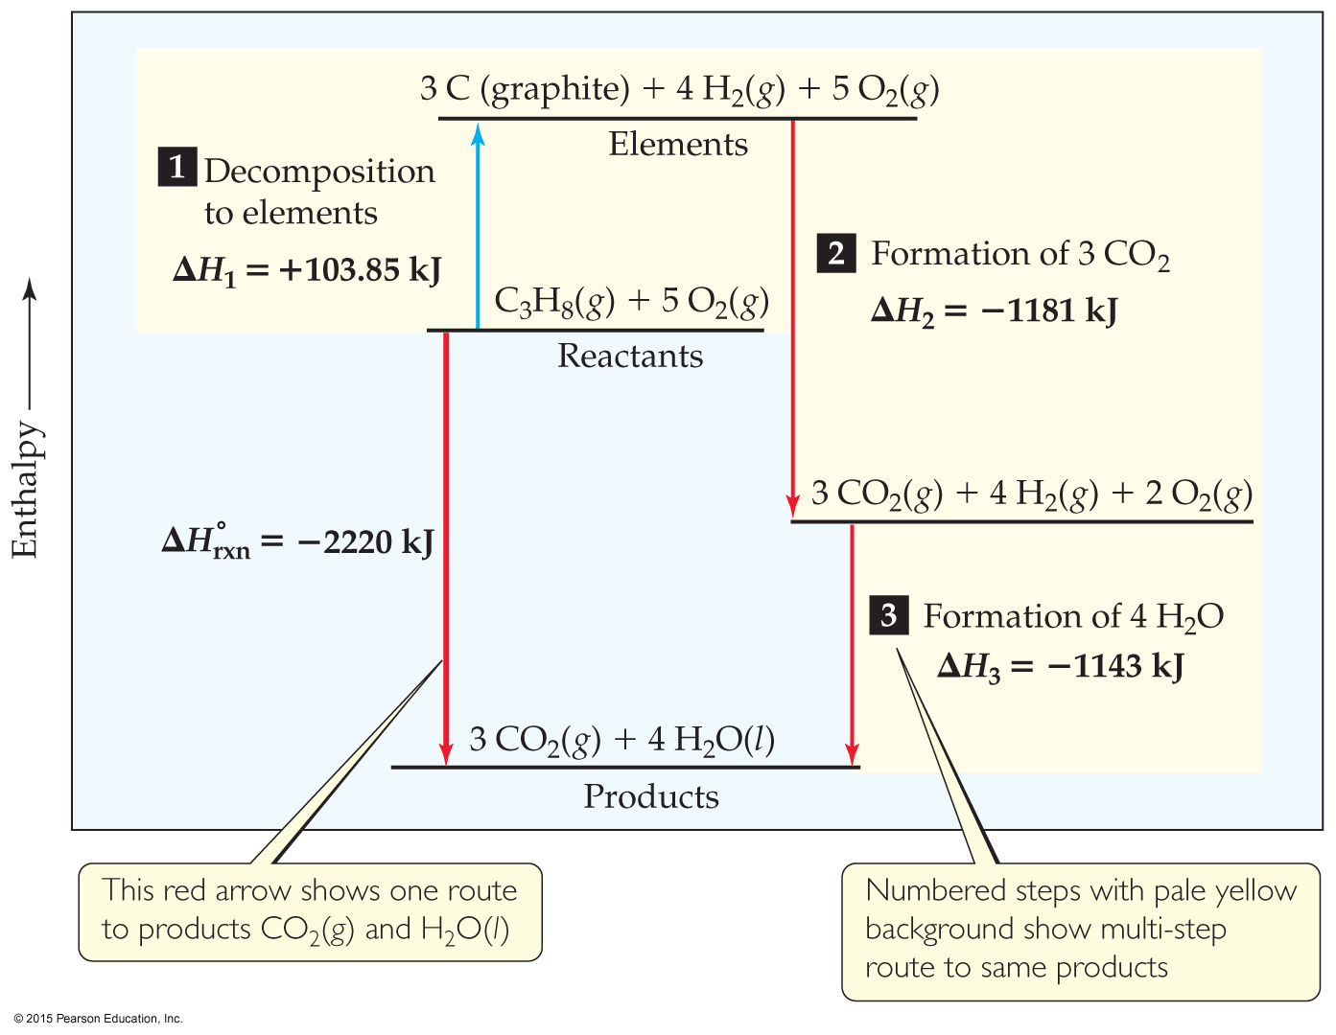
Calculation of ΔH using Values from the Standard Enthalpy Table
C₃H₈(g) + 5 O₂(g) ⎯→ 3 CO₂(g) + 4 H₂O(l)
ΔH = [3(−393.5 kJ) + 4(−285.8 kJ)] – [1(−103.85 kJ) + 5(0 kJ)]
= [(−1180.5 kJ) + (−1143.2 kJ)] – [(−103.85 kJ) + (0 kJ)]
= (−2323.7 kJ) – (−103.85 kJ) = −2219.9 kJ

Slide 15
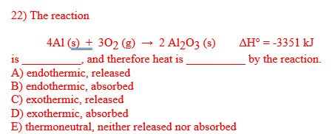
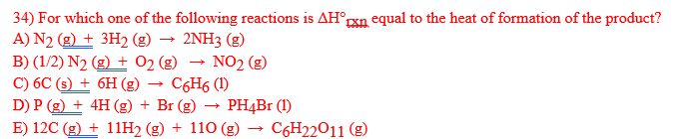
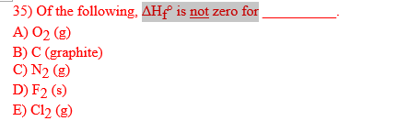

Slide 16
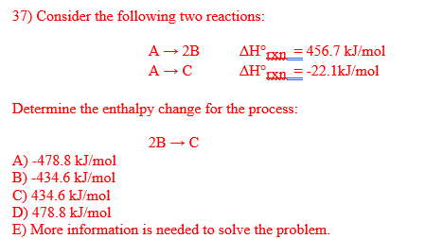

Slide 17
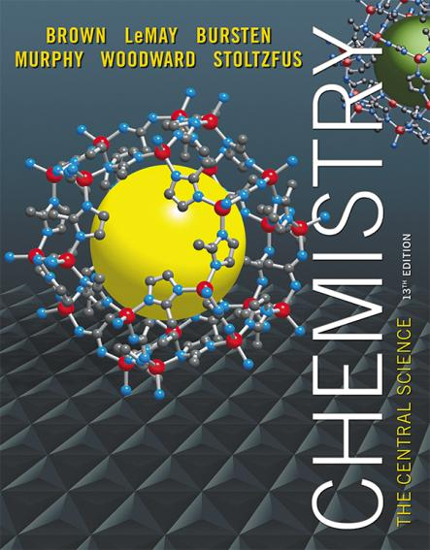
Lecture Presentation
Chapter 19 Chemical Thermodynamics
© 2015 Pearson Education, Inc.

Slide 18
Questions: what’s the similarity of the following phenomenon?
Why does hot water get cold?
Why does an orderly desk become disorganized?
Why is laziness easier than self-discipline?
Why is sleep more acceptable than work?
Why do dynasties always change, no matter how strong they are, they eventually will fall or are replaced ?
Spontaneous process
Involving energy change

Slide 19
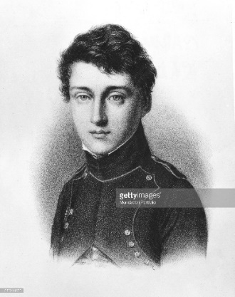
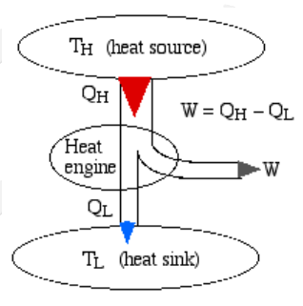
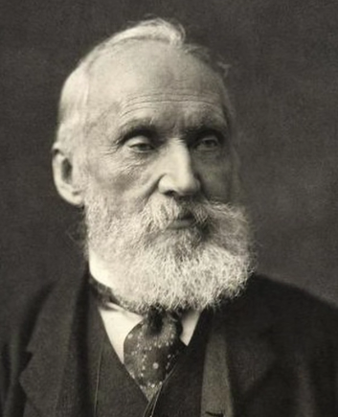
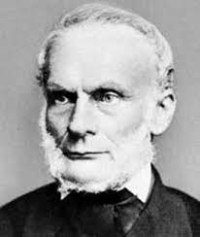
Carnot’s rule: All heat engines between two heat reservoirs are less efficient than a Carnot heat engine operating between the same reservoirs. The efficiency of the heat engine just depends on the temperature difference (ΔT)
Carnot
1796－1832
It is impossible to convert the heat from a single source into work without any other effect.
Kelvins
1824-1907
It is impossible to transfer heat from the low-temperature heat sources to a media with a higher temperature without providing the additional energy from an external source.
Clausius
1822－1888
Notes:
Scarlatina, minigitis, cholera

Slide 20
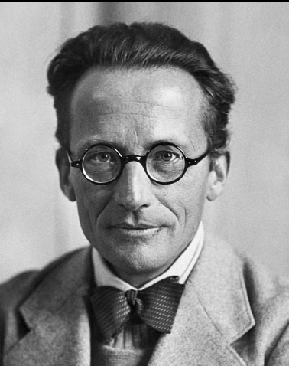
Second law of thermodynamics
The entropy of the universe increases in any spontaneous process.
1943， Shordinger introduced the entropy increase theory to biology
What is life?
The only reason life exists is to get negative entropy from the environment

Slide 21
First Law of Thermodynamics
You will recall from Chapter 5 that energy cannot be created or destroyed.
Therefore, the total energy of the universe is a constant.
Energy can, however, be converted from one form to another or transferred from a system to the surroundings or vice versa.

Slide 22
Enthalpy/Entropy
Enthalpy is the heat absorbed by a system during a constant-pressure process.
Entropy is a measure of the randomness in a system.
Both play a role in determining whether a process is spontaneous.

Slide 23
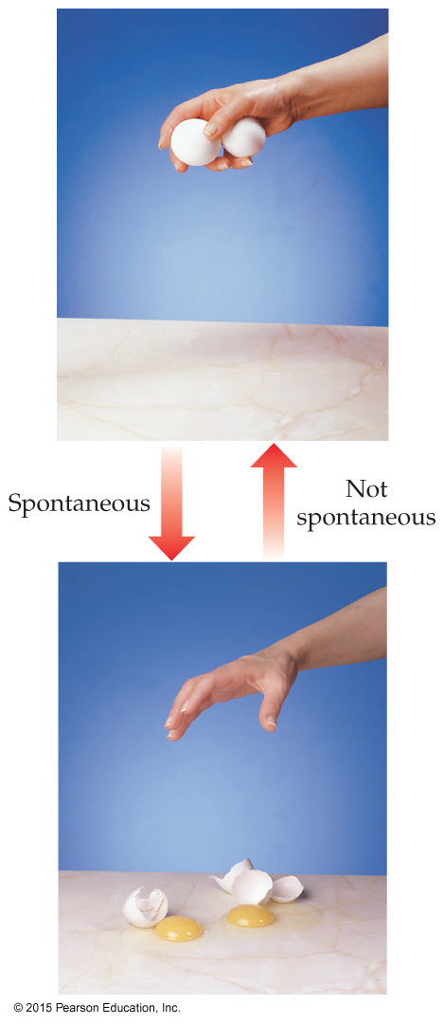
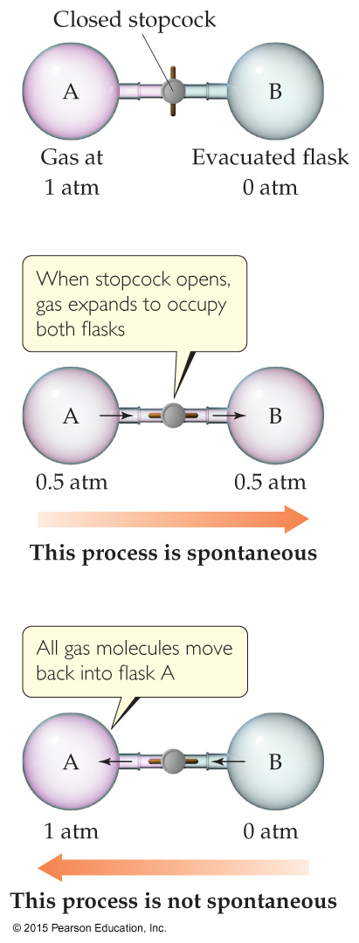
Spontaneous Processes
Spontaneous processes proceed without any outside assistance.
The gas in vessel A will spontaneously effuse into vessel B, but it will not spontaneously return to vessel A.
Processes that are spontaneous in one direction are nonspontaneous in the reverse direction.

Slide 24
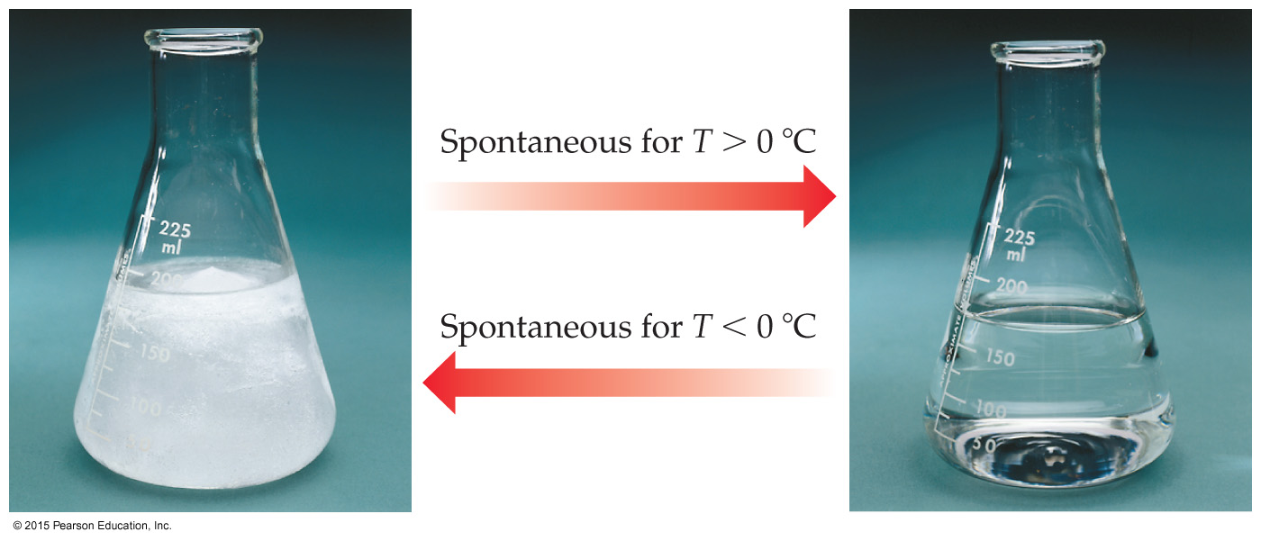
Experimental Factors Affect Spontaneous Processes
Temperature and pressure can affect spontaneity.
An example of how temperature affects spontaneity is ice melting or freezing.

Slide 25
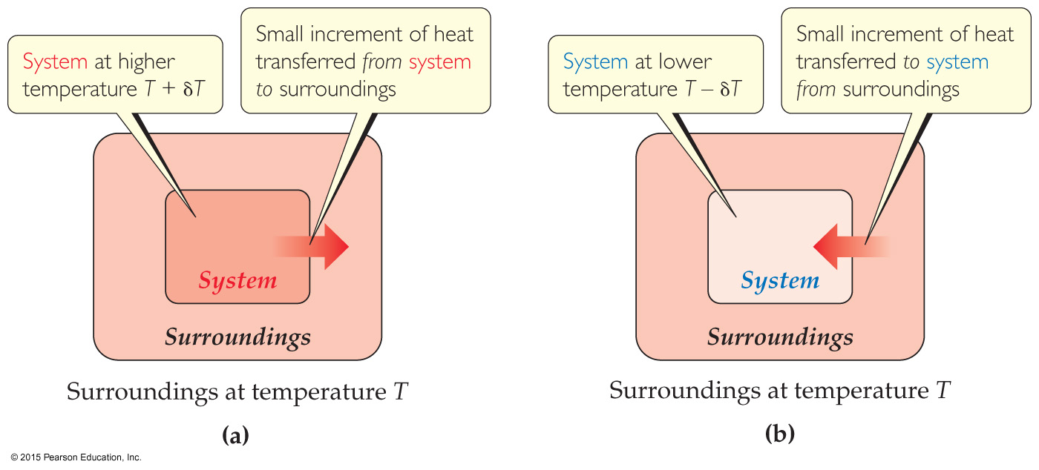
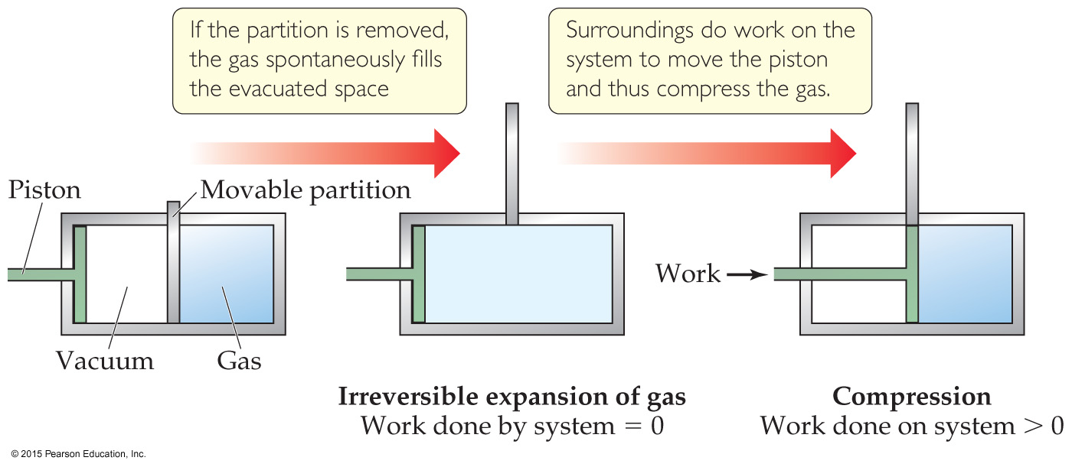
Reversible and Irreversible Processes
Reversible process: A reversible process is one for which we can restore the system to its original condition with no change to the surroundings.
Irreversible processes: An irreversible process is one that leaves the surroundings somehow changed when the system is restored to its original state

Slide 26
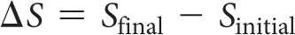
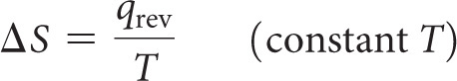
Entropy
Entropy can be thought of as a measure of the randomness of a system.
It is a state function:
It can be found by heat transfer from surroundings at a given temperature:

Slide 27
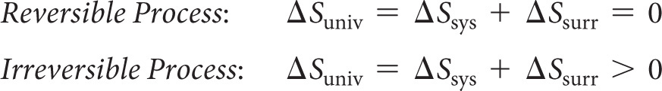
Second Law of Thermodynamics
The entropy of the universe increases in any spontaneous processes.
This results in the following relationships:

Slide 28
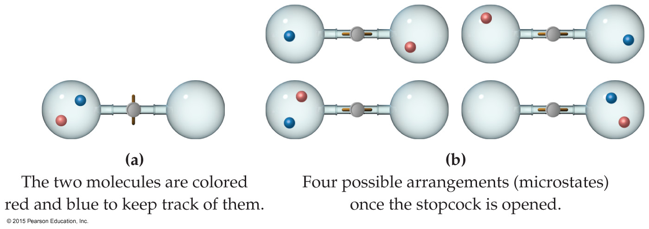
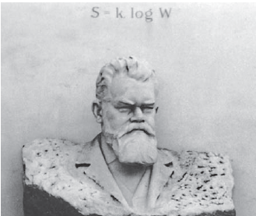
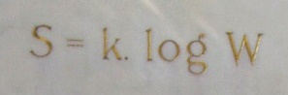
Entropy on the Molecular Scale
Boltzmann’s
gravebstone
Boltzmann described entropy on the molecular level.
Gas molecule expansion: Two molecules are in the apparatus above; both start in one side. What is the likelihood they both will end up there? (1/2)²
If one mole is used? (1/2)^{6.02×1023}! (No chance!)
Gases spontaneously expand to fill the volume given.
Most probable arrangement of molecules: approximately equal molecules in each side

Slide 29
Statistical Thermodynamics
Thermodynamics looks at bulk properties of substances (the big picture).
We have seen what happens on the molecular scale.
How do they relate?
We use statistics (probability) to relate them. The field is called statistical thermodynamics.
Microstate: A single possible arrangement of position and kinetic energy of molecules

Slide 30
Boltzmann’s Use of Microstates
Because there are so many possible microstates, we can’t look at every picture.
W represents the number of microstates.
Entropy is a measure of how many microstates are associated with a particular macroscopic state.
The connection between the number of microstates and the entropy of the system is:

Slide 31
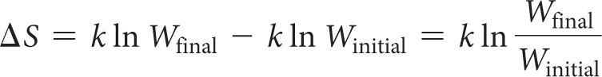
Entropy Change
Since entropy is a state function, the final value minus the initial value will give the overall change.
In this case, an increase in the number of microstates results in a positive entropy change (more disorder).

Slide 32
Effect of Volume and Temperature Change on the System
If we increase volume, there are more positions possible for the molecules. This results in more microstates, so increased entropy.
If we increase temperature, the average kinetic energy increases. This results in a greater distribution of molecular speeds. Therefore, there are more possible kinetic energy values, resulting in more microstates, increasing entropy.

Slide 33
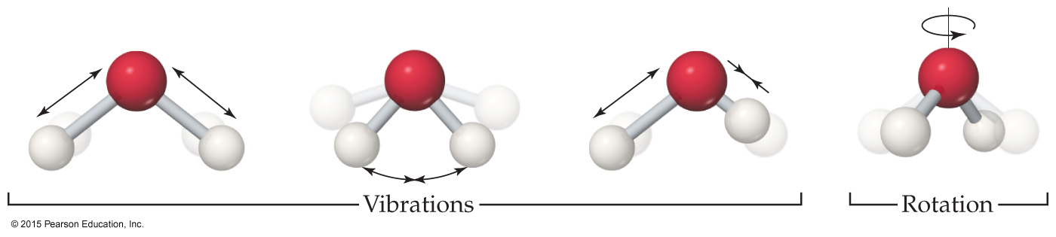
Molecular Motions
Molecules exhibit several types of motion.
Translational: Movement of the entire molecule from one place to another
Vibrational: Periodic motion of atoms within a molecule
Rotational: Rotation of the molecule about an axis
Note: More atoms means more microstates (more possible molecular motions).
Notes:
€

Slide 34
Entropy on the Molecular Scale
The number of microstates and, therefore, the entropy tend to increase with increases in
temperature.
volume.
the number of independently moving molecules.

Slide 35
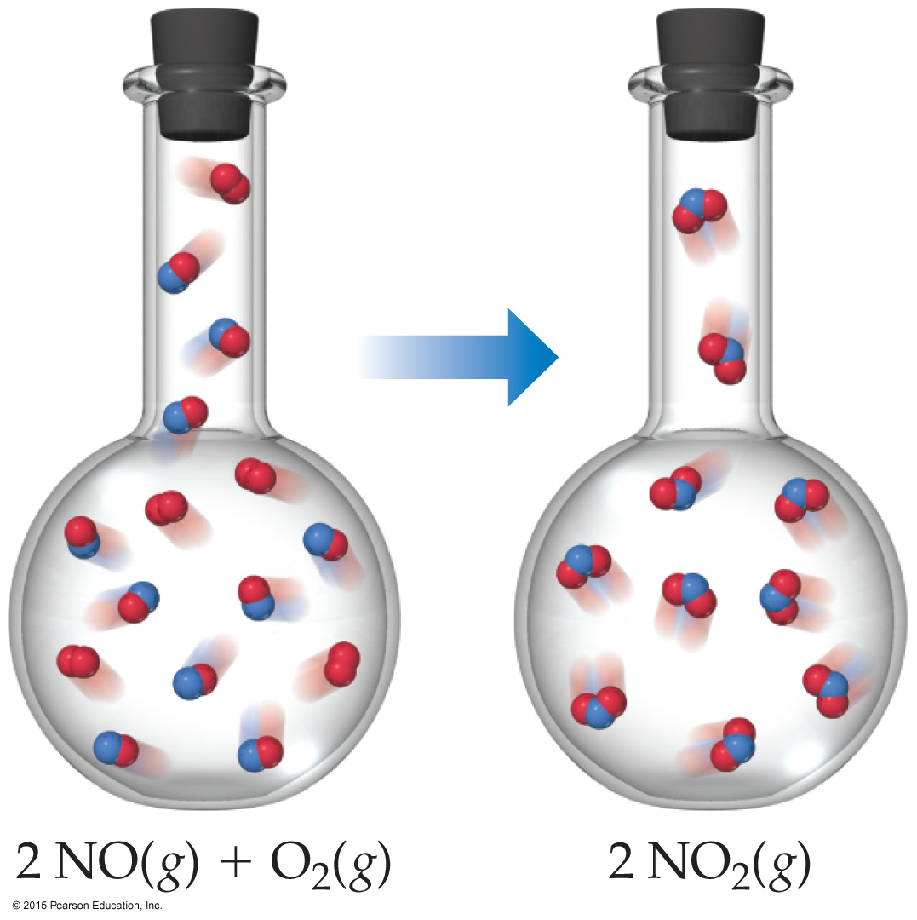
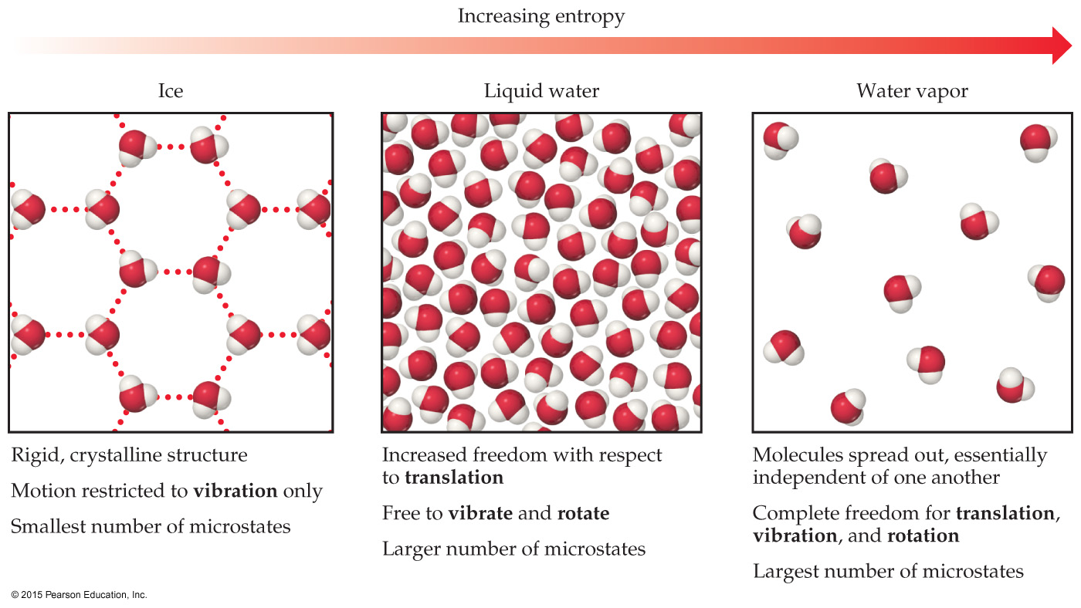
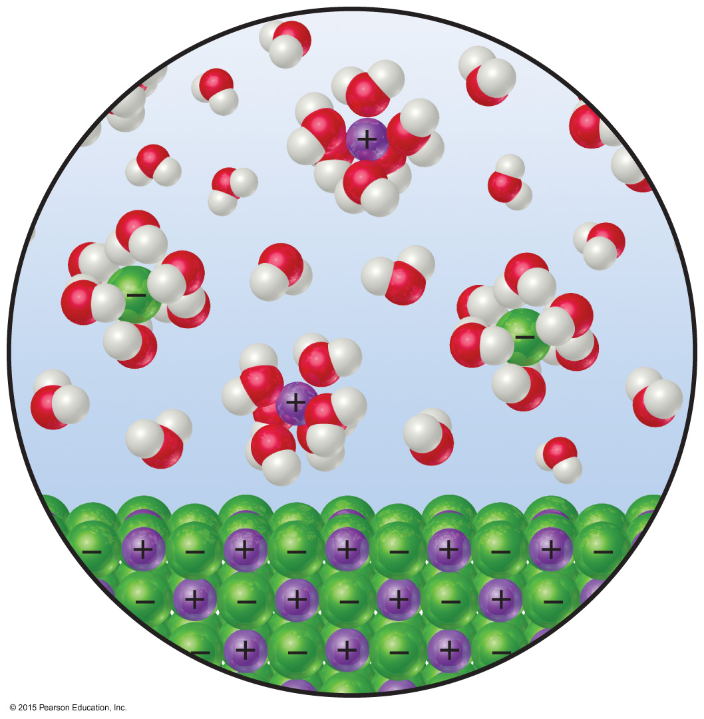
Entropy and Physical States
Entropy increases with the freedom of motion of molecules.
S(g) > S(l) > S(s)
Entropy of a system increases for processes where
gases form from either solids or liquids.
liquids or solutions form from solids.
the number of gas molecules increases during a chemical reaction.

Slide 36
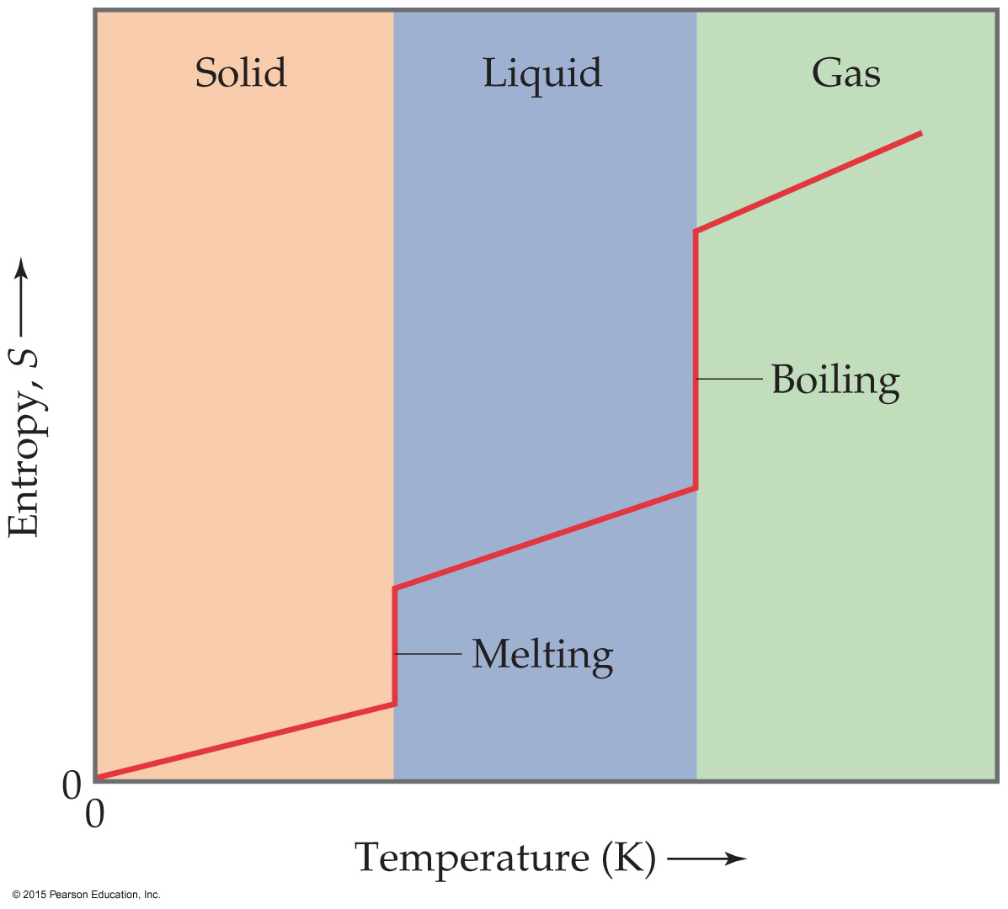
Third Law of Thermodynamics
The entropy of a pure crystalline substance at absolute zero is 0.
Consider all atoms or molecules in the perfect lattice at 0 K; there will only be one microstate.
S = k ln W = k ln 1 = 0

Slide 37
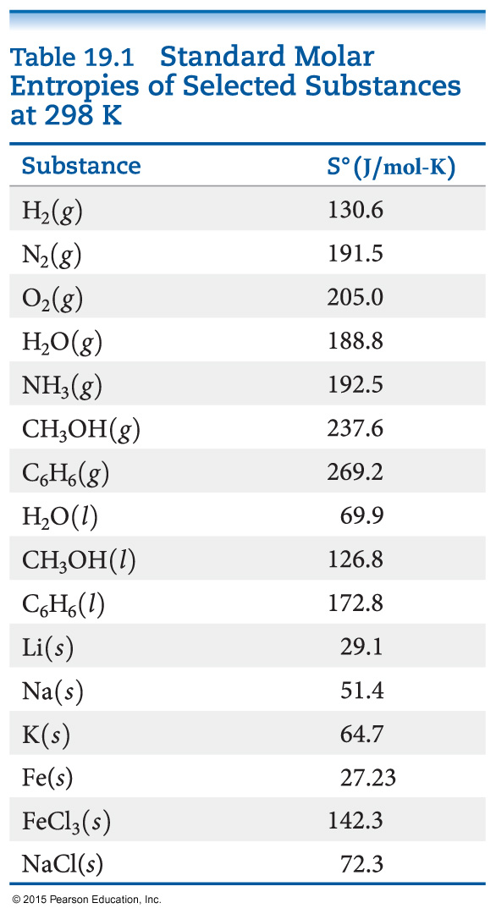
Standard Entropies
The reference for entropy is 0 K, so the values for elements are not 0 J/mol K at 298 K.
Standard molar enthalpy for gases are generally greater than liquids and solids. (Be careful of size!)
Standard entropies increase with molar mass.
Standard entropies increase with number of atoms in a formula.

Slide 38
Entropy Changes
Entropy changes for a reaction can be calculated in a manner analogous to that by which ΔH is calculated:
ΔS° = ΣnΔS°(products) – ΣmΔS°(reactants)
where n and m are the coefficients in the balanced chemical equation.

Slide 39
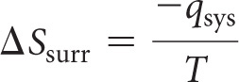

Entropy Changes in Surroundings
Heat that flows into or out of the system changes the entropy of the surroundings.
For an isothermal process
At constant pressure, q_{sys} is simply ΔH for the system.

Slide 40
Entropy Change in the Universe
The universe is composed of the system and the surroundings.
Therefore,
ΔS_{universe} = ΔS_{system} + ΔS_{surroundings}
For spontaneous processes
ΔS_{universe} > 0

Slide 41
Total Entropy and Spontaneity
ΔS_{universe} = ΔS_{system} + ΔS_{surroundings}
Substitute for the entropy of the surroundings:
ΔS_{universe} = ΔS_{system} – ΔH_{system}/T
Multiply by −T:
−TΔS_{universe} = −TΔS_{system} + ΔH_{system}
Rearrange:
−TΔS_{universe} = ΔH_{system} − TΔS_{system}
Call −TΔS_{universe} the Gibbs Free Energy (ΔG):
ΔG = ΔH − T ΔS

Slide 42
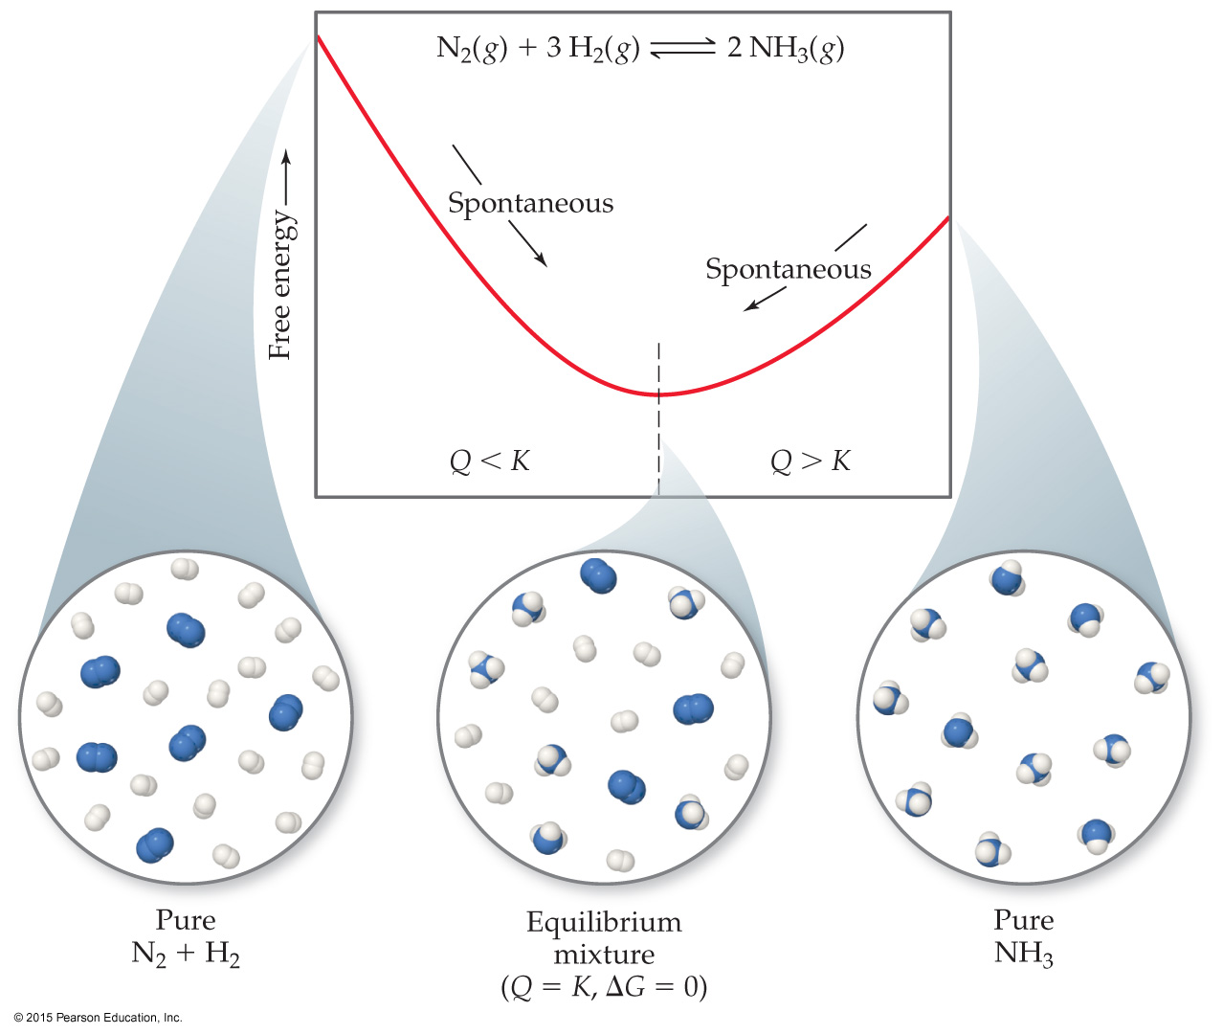
Gibbs Free Energy
If ΔG is negative, the forward reaction is spontaneous.
If ΔG is 0, the system is at equilibrium.
If ΔG is positive, the reaction is spontaneous in the reverse direction.

Slide 43
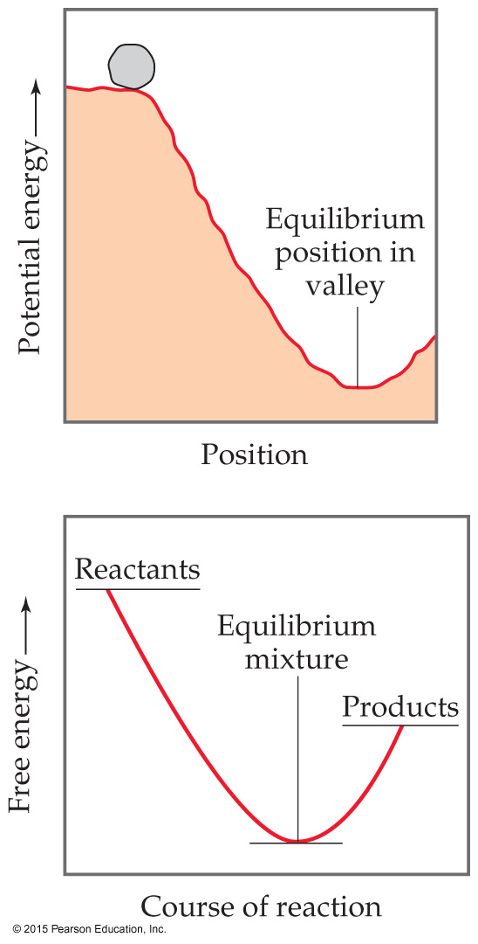
Standard Free Energy Changes
Analogous to standard enthalpies of formation are standard free energies of formation, ΔG_{f}°:
where n and m are the stoichiometric coefficients.

Slide 44
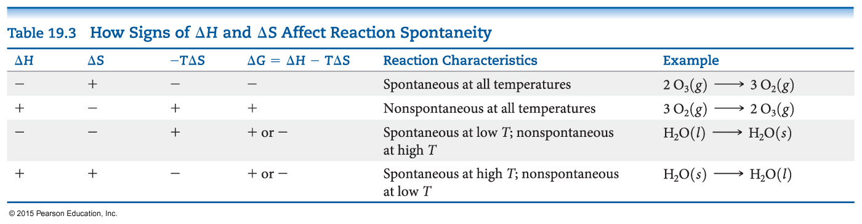
Free Energy Changes
How does ΔG change with temperature?
ΔG = ΔH – TΔS
Since reactions are spontaneous if ΔG < 0, the sign of enthalpy and entropy and the magnitude of the temperature matters to spontaneity.

Slide 45
Free Energy and Equilibrium
Under any conditions, standard or nonstandard, the free energy change can be found this way:
ΔG = ΔG° + RT ln Q
(Under standard conditions, concentrations are 1 M, so Q = 1 and ln Q = 0; the last term drops out.)

Slide 46
Free Energy and Equilibrium
At equilibrium, Q = K, and ΔG = 0.
The equation becomes
0 = ΔG° + RT ln K
Rearranging, this becomes
ΔG° = −RT ln K
or
K = e
−ΔG°/RT

